Slide 1
International Business
22MBA401
CORE SUBJECT
                Course Coordinator:
                Prof. Madhunayaka
                Assistant Professor,
                Department of MBA,
                VVIET , Mysuru

Slide 2
Module-5 (6Hours)
Multi-National Corporations: Definition and Meaning, factors that contributed to positive growth of MNCs,
Importance of MNCs, Advantages and disadvantages of MNCs, MNCs in India, Organizational structure of
MNCs, Transfer of Technology, Global Competitiveness, Indicators of competitiveness, Technology of Global competitiveness.
Contents of MODULE - 5

Slide 3
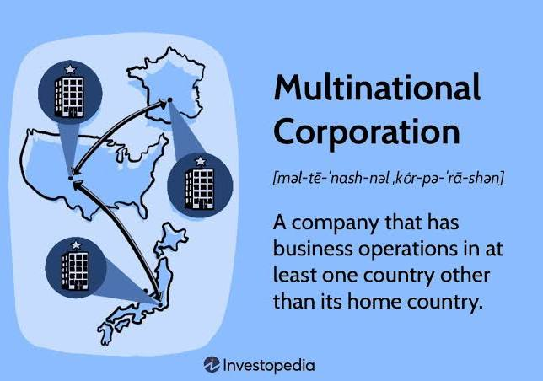
Multi-National Corporations: Definition and Meaning
Nature of MNCs
Huge Size
International Operations
Oligopolistic Power
Transfer of Resources
International Market
Refined Technology
Professional Management
Single Managerial Control
Offers Economies of Scale
Integrated Worldwide Business System

Slide 4
Factors that contributed to positive growth of MNCs
Capital
Technology
Skill
Exports
Level of Integration
Welfare of the Citizens
Investing in Local Labour
Developing a Country through FDI
Political Improvement
FDI through MNCs is Far Easier

Slide 5
Importance of MNCs
Importance to Host Country
a. Better Access to Worldwide Markets
b. Better Access to Capital Investment
c. Transfer of Technology through R&D
d. Local Supplier Development
e. New Jobs for Labour
f. Advanced Training for Labour
g. Better Access to Managerial Talent
h. Better Products for Consumers at Lower Cost
i. Contribution to Exports
2. Importance to Home Country
a. Economical growth
b. Employment opportunities
c. Expansion of domestic market by Exporting finished goods

Slide 6
Disadvantages of MNCs
Challenges to Host Country
a. Drain of Resources for Profit Maximisation
b. Strain of Scare Foreign Exchange Reserves
c. Minimum Technology Transfer
d. Insignificant Employment Potential
e. Interference in States’ Sovereignty
f. Influence on Culture
2. Challenges to Home Country
a. Loss of Employment
b. Repatriation Issues
c. Possibility of Losing Competitive Advantage

Slide 7
MNCs in India
MNCs have a long history in India, dating back to the colonial era with companies like the British East India Company and the Dutch East India Company. However, their significant presence and growth accelerated after India's 1991 economic liberalization, which attracted a large influx of foreign investment and brought companies across various sectors. Today, India hosts thousands of MNCs, contributing to its economy through technology transfer, job creation, and integration into the global market.
Examples of MNCs in India
Pre-Independence: Philips, Siemens, Unilever (Lever Brothers), GE, and Standard Chartered Bank.
Post-Independence: Shell (though its subsidiary was established in 1928).
Modern Era: IBM, Microsoft, Google, Nestlé, Coca-Cola, Pfizer, and Tata Consultancy Services.

Slide 8
Current Opportunities of Indian MNCs
Rapid Domestic Economic Growth
International Expansion Strategy
Factor Mobility
Economic Reforms
Market Potential
Development in Communication Technology

Slide 9
Organizational structure of
MNCs,
Organization Structures
International Divisions Structure
Functional Divisions Structure
Product Division Structure
Geographic (Area) Division Structure
Matrix Division Structure
Mixed Structure

Slide 10
Transfer of Technology
Transfer of Technology is the process through which technologies, knowledge, skills, manufacturing techniques, facilities between government and other institutions are shared in order to ensure that a large number of users having potential to develop and utilize existing technology to create new and better process, products, materials services, applications etc., can easily access new technological and scientific development.
Reasons for Transfer of Technology
Profit from Selling Technology
Locations and Logistics advantage
Competitive Advantage
Government Policies
Market Saturation
Competitive Enhancement

Slide 11
Transfer of Technology
Methods of Technology Transfer
Foreign Direct Investment
Licensing
Franchising
Management Contracts or/and Turnkey Arrangement
Contract Manufacturing
Joint Venture
Importance of Technology Transfer
Promotes Technological Use
Develops Competitive Edge
Encourages Research and Development
Enhances Capability and Innovation
Helps Researchers

Slide 12
Global Competitiveness
The rise of globalization in the Internation Business has led to intense competition because of which high technology sector had become a major part of foreign trade.
Need for Global Competitiveness
Evaluate the Capability of Countries
Renew and Regenerate
Provide New Viewpoint and Information Competitiveness
Facing International Competition
Re-Examination of Products, Customers, Markets, and Rivals.

Slide 13
Indicators of competitiveness/12 Pillars of Global Competitiveness
Institutions
Infrastructure
Macroeconomic Stability
Health and Primary Education
Higher Education and Training
Goods Market Efficiency
Labour Market Efficiency
Financial Market Sophistication
Technological Readiness
Market Size
Business Sophistication
Innovation

Slide 14
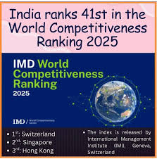
Indicators of competitiveness/12 Pillars of Global Competitiveness
India ranked 41st out of 69 countries in the 2025 International Institute for Management Development (IMD) World Competitiveness Ranking, a drop of two spots from its 39th position in 2024. Switzerland remained the most competitive economy, with Singapore and Hong Kong securing the second and third spots, respectively. While India performs well in economic performance and business efficiency, weaknesses in infrastructure and government effectiveness impact its overall competitiveness.

Slide 15
Technology of Global competitiveness.
Technology drives global competitiveness by fostering innovation, increasing productivity, reducing costs, and enabling access to new markets
How Technology Boosts Competitiveness
Innovation: Developing new technologies creates new products and services, enhancing industry-specific advantages.
Adoption: Introducing and integrating technologies developed elsewhere can significantly improve living standards and long-term economic growth.
Efficiency & Cost Reduction: Technology streamlines operations, reduces production costs, and optimizes supply chains, improving a company's profitability.
Market Access: Digital tools facilitate real-time collaboration and provide businesses with broader access to global markets.
Productivity: Technology increases the productivity and quality of goods and services, leading to higher incomes for citizens and faster economic growth.

Slide 16
Thank You

